Slide 1
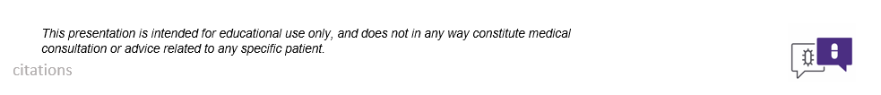
Pharmacotherapy for COVID-19
Zahra Kassamali Escobar, PharmD

Slide 2
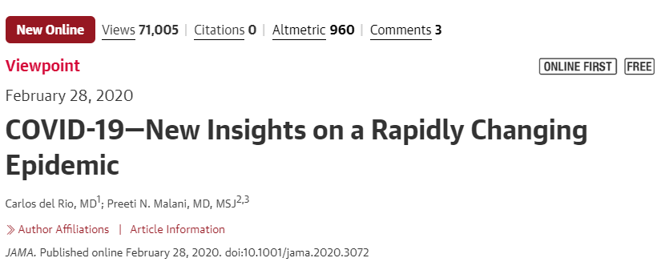
Where do I start?

Slide 3
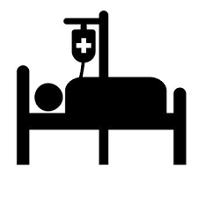
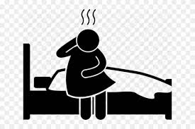
Who are we going to treat?

Slide 4
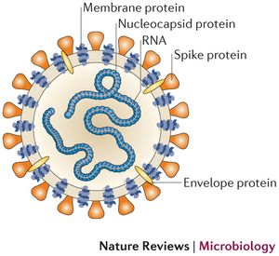
Overview of the Pharmacotherapy Approach
Direct antiviral action Inhibit viral operations Enhance immune response
Tan et al. Emerg Infect Dis. 2004;581-86.
doi: 10.3201/eid1004.030458
Notes:
ZKE- I found more published data with kaletra improving responses in SARS in patients than any other treatment. But upfront treatment made the difference vs. “rescue therapy”

Slide 5
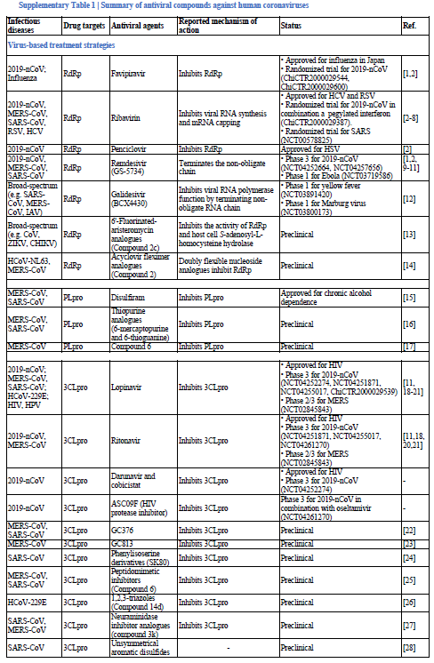
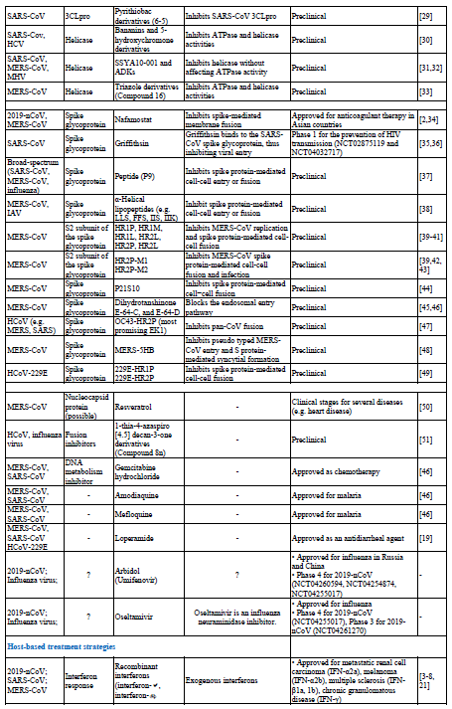
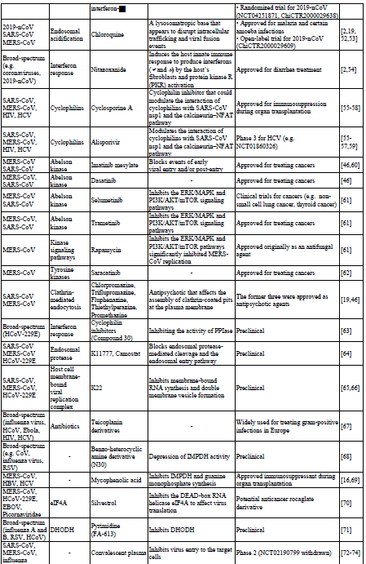
Treatments
Li and De Clercq. Therapeutic Options for the 2019 novel coronavirus (2019-nCoV).
https://www.nature.com/magazine-assets/d41573-020-00016-0/17663286 Update 19 Feb 2020

Slide 6
Nucleoside Analogues
What: Nucleotide bases get incorporated into the viral genome (RNA) when it replicates Why: They thwart the replication process because they are nucleoside imposters Drugs:
FDA-Approved | Investigational
Ribavirin (guanine analog) Higher doses required to for activity vs. SARS-CoV | Remdesivir (adenine derivative) Phase 3 trial is ongoing
Favipiravir (guanine analog) approved for flu in Japan | Galidesivir (adenosine analog) Phase I studies/Safety & Efficacy
Li and De Clercq. Therapeutic Options for the 2019 novel coronavirus (2019-nCoV).
https://www.nature.com/magazine-assets/d41573-020-00016-0/17663286 Update 19 Feb 2020
Notes:
Ribavirin has activity vs. HCV and RSV. Active against SARS and MERS but associated with a lot of toxicity (anemia)
Favipiravir has activity vs. influenza, ebola, yellow fever, chikungunya, norovirus, and enterovirus, 2019-nCoV (in cell cultures)

Slide 7
Protease Inhibitors (PI)
What: Viral proteases cut up proteins for packaging in budding viruses and are essential for viral replication Why: Inhibiting this enzyme is a mainstay of HIV therapy
Data: Lopinavir/ritonavir has shown activity vs. SARS and MERS Issue: The chemical structure of protease in 2019-nCoV is different than the HIV protease rendering the lock and key fit of this drug’s activity questionable. Translation: PIs may have activity but potency is a concern
Li and De Clercq. Therapeutic Options for the 2019 novel coronavirus (2019-nCoV).
https://www.nature.com/magazine-assets/d41573-020-00016-0/17663286 Update 19 Feb 2020
Notes:
ZKE- I found more published data with kaletra improving responses in SARS in patients than any other treatment. But upfront treatment made the difference vs. “rescue therapy”

Slide 8
Immune Enhancers
What: Stimulate innate immunity in the host Why: Theoretically could be used in combination with nucleoside analog (like HCV treatments of past) For Example: Peg-Interferon But: SO many side effects Clinical trials underway in China
Li and De Clercq. Therapeutic Options for the 2019 novel coronavirus (2019-nCoV).
https://www.nature.com/magazine-assets/d41573-020-00016-0/17663286 Update 19 Feb 2020

Slide 9
Approach
Supportive care Supportive care Supportive care Pharmacotherapy

Slide 11

March 10, 2020
Management of Healthcare Workers Exposed to COVID-19
Nandita Mani, MD
UW Infectious Diseases Fellow

Slide 12
Defining “exposure”
Close contact for healthcare exposures is defined as:
being within approximately 6 feet of a person with COVID-19 for a prolonged period of time OR
having unprotected direct contact with secretions of the patient (e.g., being coughed on, touching used tissues with a bare hand).
Source: CDC
Notes:
Data are limited
It all depends on what happened during your exposure – did patient cough into your face? What is prolonged??

Slide 13
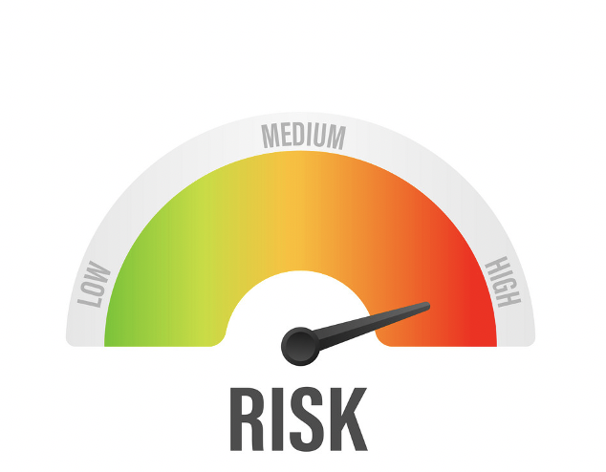
Not all exposures are equal
HIGH RISK EXPOSURES:
prolonged close contact with COVID-19 patient who was not wearing a facemask while HCW nose and mouth were exposed to infectious material
being present in the room for procedures that generate aerosols (e.g., CPR, intubation, extubation, bronchoscopy, nebulizer therapy, sputum induction) without appropriate PPE

Slide 14
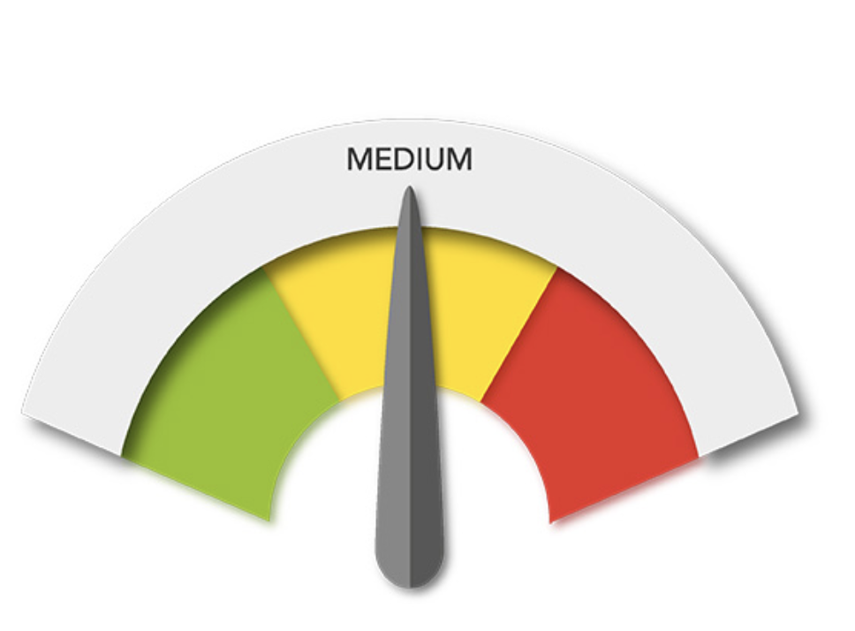
Exposures, cont’d
MEDIUM-RISK EXPOSURES
HCW had prolonged close contact with COVID-19 patient who was wearing a facemask and HCW was not wearing appropriate PPE
HCW was wearing a gown, gloves, eye protection and a facemask (instead of a respirator) during an aerosol-generating procedure

Slide 15
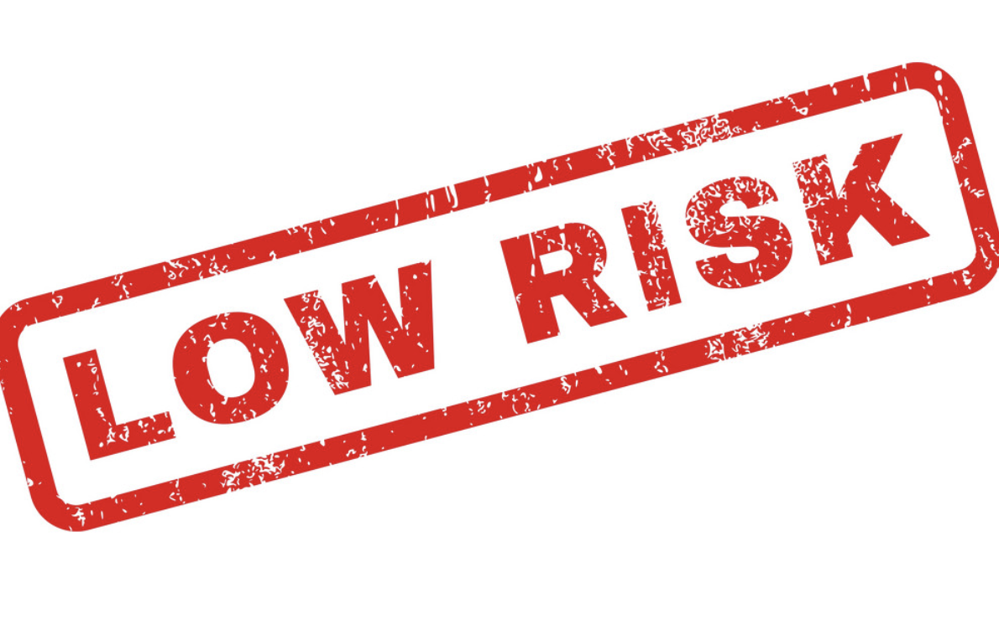
Exposures, cont’d
LOW RISK EXPOSURES
Brief interactions with patients with COVID-19 or prolonged close contact with patients while HCW is wearing appropriate PPE
NO IDENTIFIABLE RISK:
HCW had no direct patient contact and no entry into active patient management areas who adhere to routine safety precautions do not have a risk of exposure to COVID-19

Slide 16
“I’VE BEEN EXPOSED”
NOW WHAT?

Slide 17
CDC RECOMMENDATIONS
High or medium risk, asymptomatic → monitor for symptoms, self-isolate, no work for 14 days
Low risk, asymptomatic → self-monitoring with delegated supervision for 14 days, can go to work
Symptomatic → stay at home!

Slide 18
What are we doing at Harborview Medical Center?
Contact tracing for every COVID-positive patient
Call exposed HCW; inform them of exposure; identify whether they have symptoms
No symptoms? Twice daily electronic symptom survey
Symptoms? Stay at home; get tested for flu/RSV/COVID-19

Slide 20
FAQ for UW Medicine Employees
1. I’m sick with an acute respiratory infection. What should I do?
You should remain at home. You cannot work while ill with a respiratory illness.
If you need medical care, you should contact your primary physician. If urgent care is needed, please call the urgent care clinic or emergency department before coming in.
Call your manager to let them know.

Slide 21
FAQ, cont’d
2. Can I get tested for COVID-19?
  Employees who call out sick with an acute respiratory infection, including the following symptoms, may sign up for testing:
  o Fever OR
  o New cough OR
  o New shortness of breath
3. Is testing for COVID-19 mandatory? No.
4. Is testing confidential? We only inform your manager of a positive test if you worked while you were ill. We do this in order to contact exposed co-workers who may need to be tested.

Slide 22
FAQ, cont’d
5. I tested negative for COVID-19. When can I return to work? You may return to work when you are asymptomatic for 24 hours. This applies even if you tested positive for influenza or RSV.
6. I tested positive for COVID-19. When can I return to work?
If you have tested positive for COVID-19, you should remain under home isolation precautions for a minimum of 7 days from symptom onset and you must be symptom-free for 72 hours before you can return to work.

Slide 23
FAQ, cont’d
7. I recently had a fever, cough, or shortness of breath, but I did NOT get tested for COVID-19. When can I return to work? If you met criteria for testing but did not get tested, you should remain under home isolation precautions until you are symptom-free for 72 hours.
8. What should I do if I have respiratory symptoms but I don’t have fever, new cough, or shortness of breath?
You do not meet criteria for COVID-19 testing at this time through Employee Health. You may be able to obtain testing elsewhere.
You should remain at home while you are ill and may return to work when you are symptom-free for 72 hours.

Slide 24
Lessons learned
Clear, consistent communication is key
Every healthcare system has unique considerations → personalize your policies
Prepare your providers for evolving protocols
Making sure your staff feels safe is critical
Ideal protocols may not be practical to implement
  ED: started with targeted contact tracing → now asking all ED staff to regularly monitor symptoms

Slide 25
Questions? Let us know!
nsmani@uw.edu

